Slide 1
December Peak Oil Chat
John Peach
12/4/2024

Slide 2
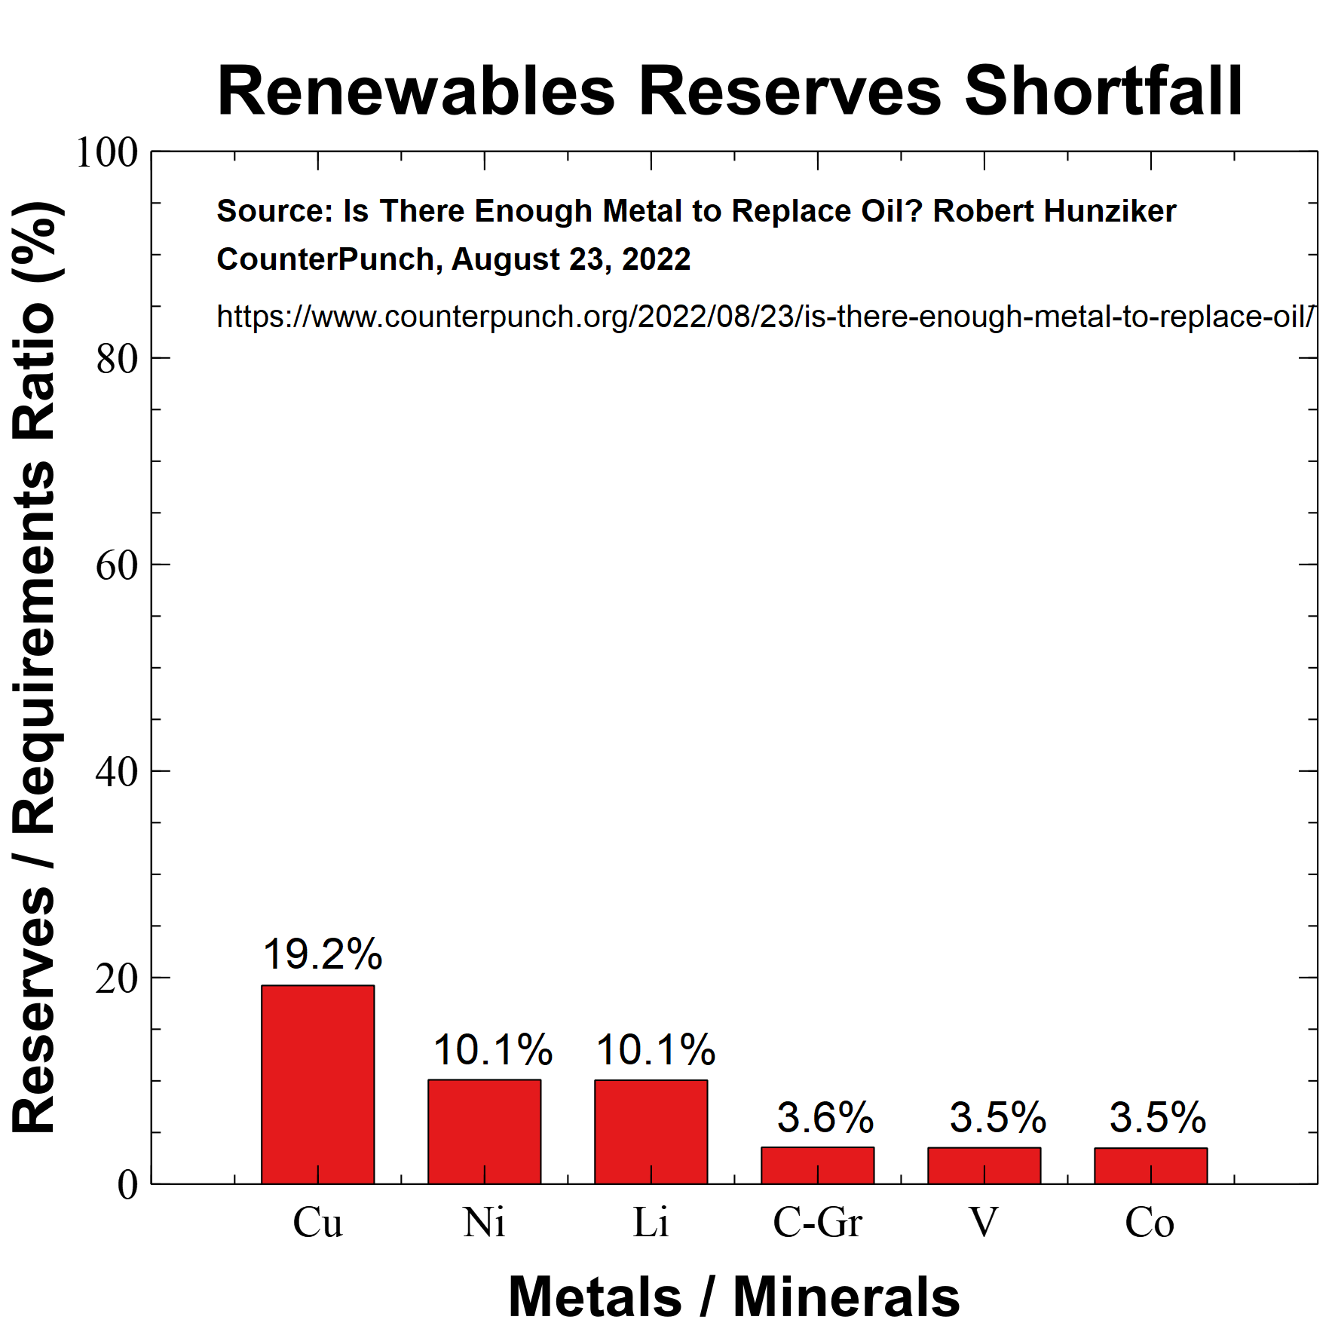
Renewable Ore Reserves and Rates
Simon P. Michaux
Associate Professor Mineral Processing & Geometallurgy

Slide 3
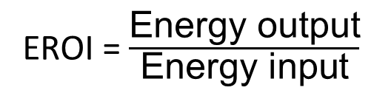
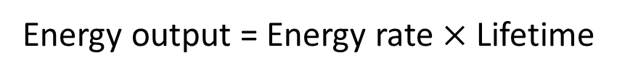
Renewable Energy Rates
Energy Source | EROI
Oil | 20.4
Coal | 46.3
Natural Gas | 7.0
Tar Sands | 3.5
Shale Oil | 7.5
Wind | 20.8
Solar | 9.3
Nuclear | 13.9
Hydro | 84.0
Geothermal | 9.0
EROI = $\frac{\text{Energy} \text{output}}{\text{Energy} \text{input}}$
Energy output = Energy rate $×$ Lifetime
Ref: EROI of different fuels and the implications for society
Hall, Lambert, Balogh. Energy Policy, Jan 2014.

Slide 4
Renewable Energy Rates
Energy Source | EROI | Lifetime
Oil | 20.4 | 0.5
Coal | 46.3 | 0.5
Natural Gas | 7.0 | 0.4
Tar Sands | 3.5 | 0.5
Shale Oil | 7.5 | 0.5
Wind | 20.8 | 25.0
Solar | 9.3 | 25.0
Nuclear | 13.9 | 50.0
Hydro | 84.0 | 75.0
Geothermal | 9.0 | 35.0
Time from source to endpoint very short
Energy input mostly transportation, refining
System lifetimes long
Energy input mostly during construction

Slide 5
Renewable Energy Rates
Energy Source | EROI | Lifetime | EROI Rate
Oil | 20.4 | 0.5 | 37.8
Coal | 46.3 | 0.5 | 92.5
Natural Gas | 7.0 | 0.42 | 16.5
Tar Sands | 3.5 | 0.54 | 6.4
Shale Oil | 7.5 | 0.54 | 13.9
Wind | 20.8 | 25.0 | 0.8
Solar | 9.3 | 25.0 | 0.4
Nuclear | 13.9 | 50.0 | 0.3
Hydro | 84.0 | 75.0 | 1.1
Geothermal | 9.0 | 35.0 | 0.3
Minimum EROI rate ~ 20-30?
Not long-term viable energy sources

Slide 6
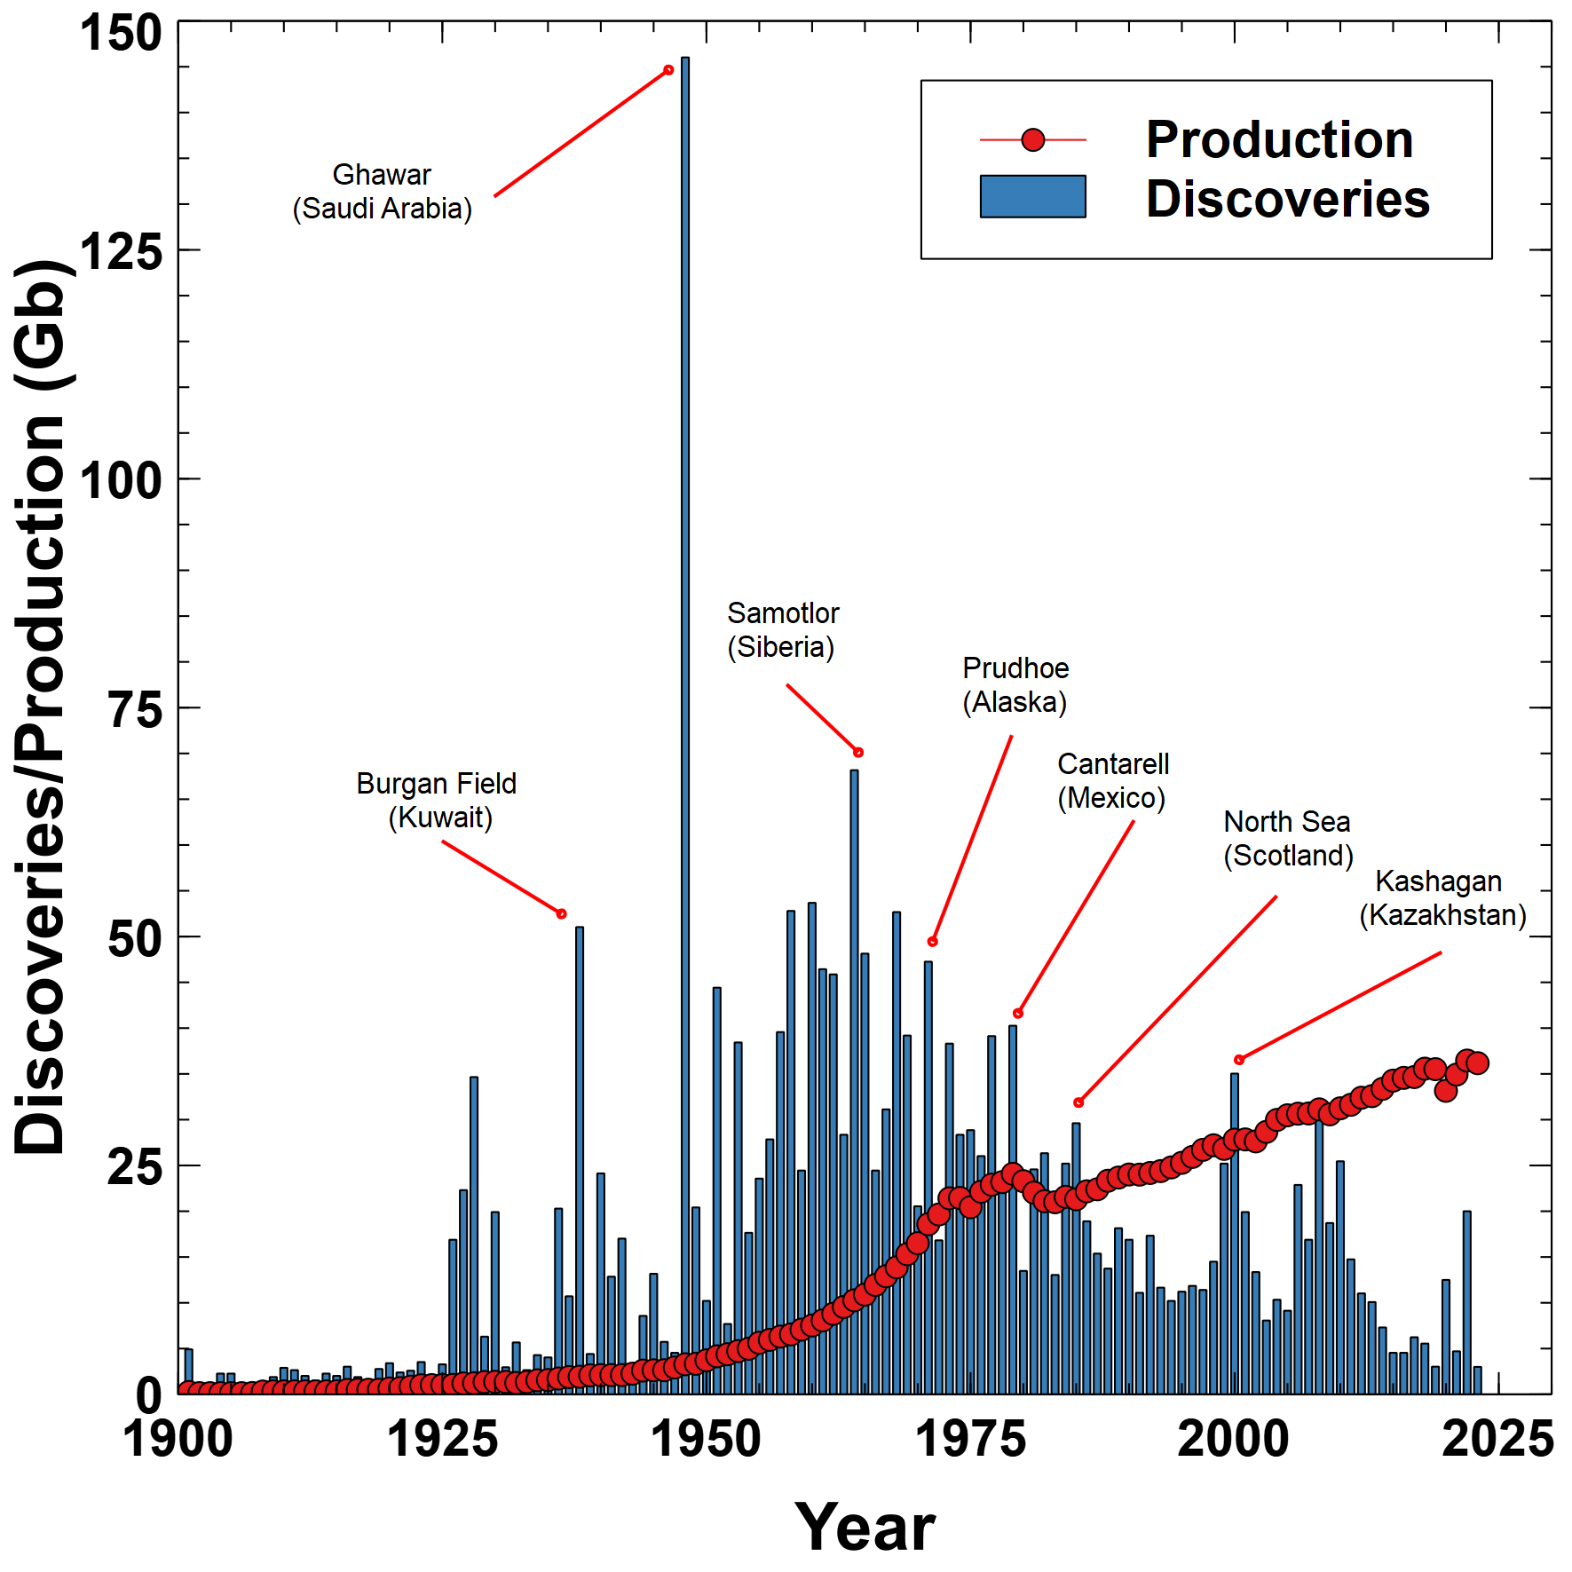
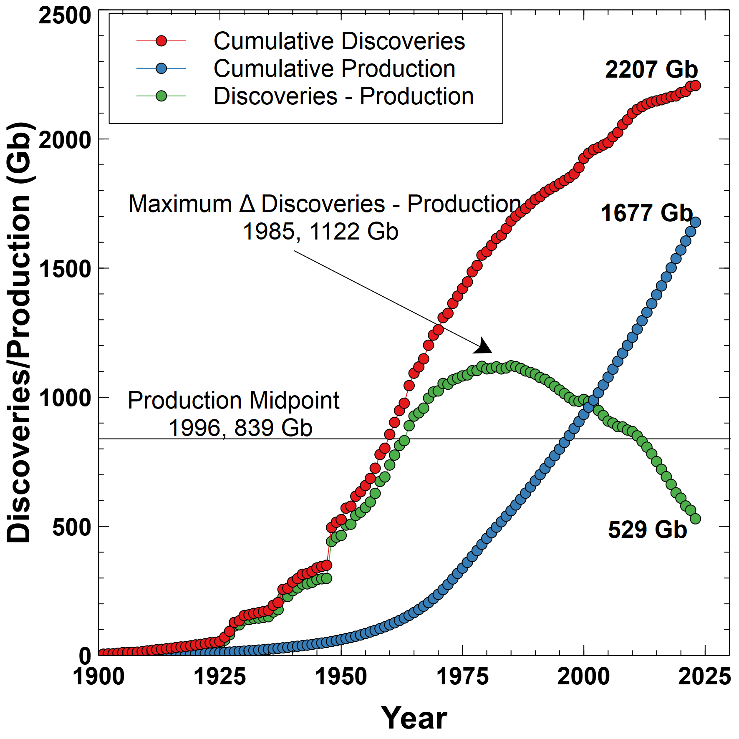
Oil Discoveries and Production
Ref: How much oil remains for the world to produce? Comparing assessment methods, and separating fact from fiction
Laherrere, Hall, Bentley, Current Research in Environmental Sustainability, Vol 4 2022.

Slide 7
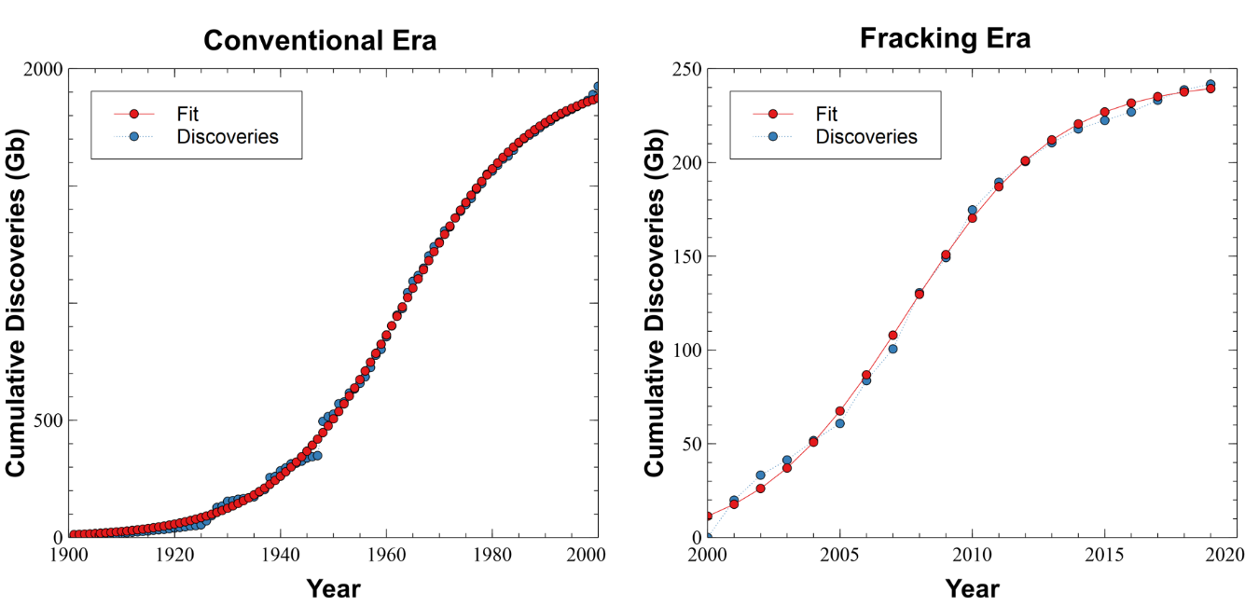
Logistic Discovery Model
Total projected discoveries = 2240 Gb
Total discoveries to date = 2207 Gb
Annual production ~ 36 Gb

Slide 8
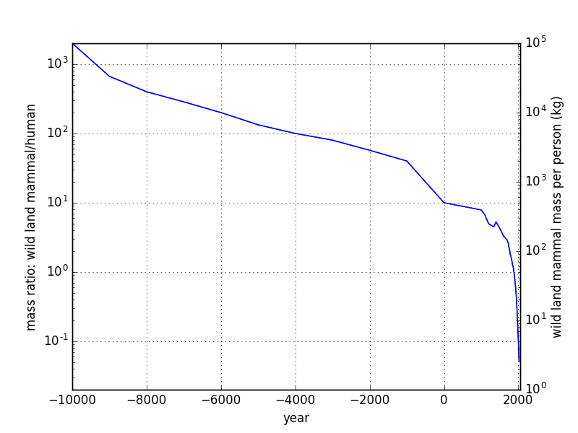
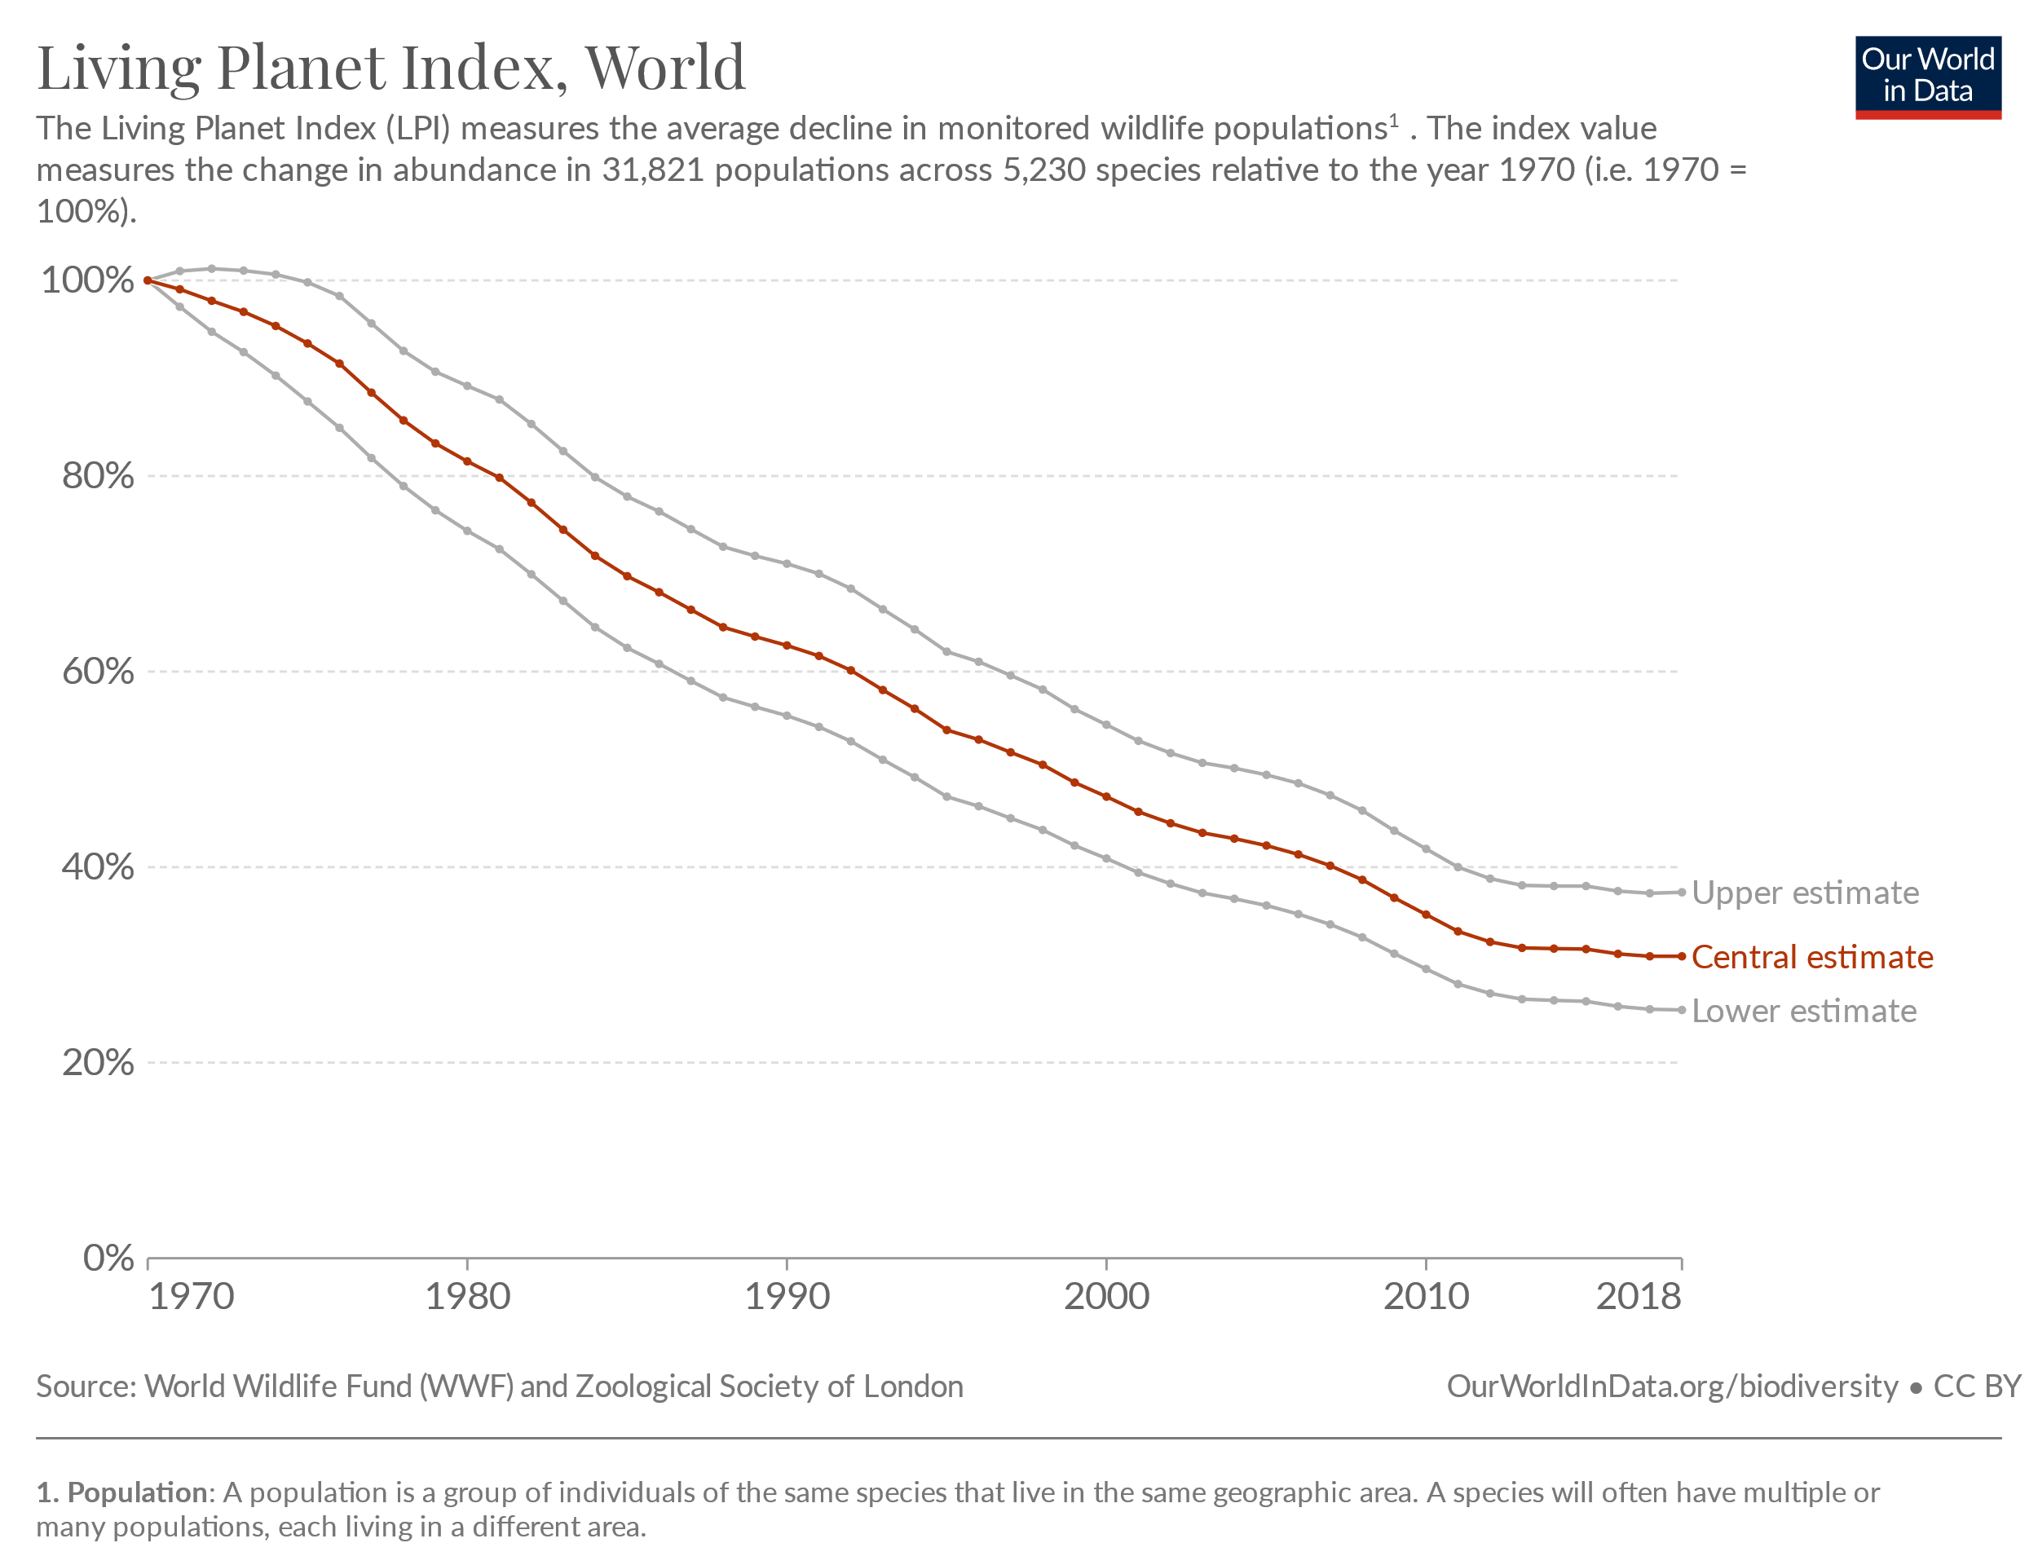
Biodiversity
“We have used it [energy] to expand the human enterprise and population, knock down forests, destroy and fragment habitats, drive extinctions, and generally threaten the vitality of the planet” – Tom Murphy, UCSD Astrophysics.

